Slide 1
Segmentation

Slide 2
Segmentation
Memory-management scheme that supports user view of memory
A program is a collection of segments
A segment is a logical unit such as:
main program procedure function method object
local variables, global variables common block
stack
symbol table arrays

Slide 3
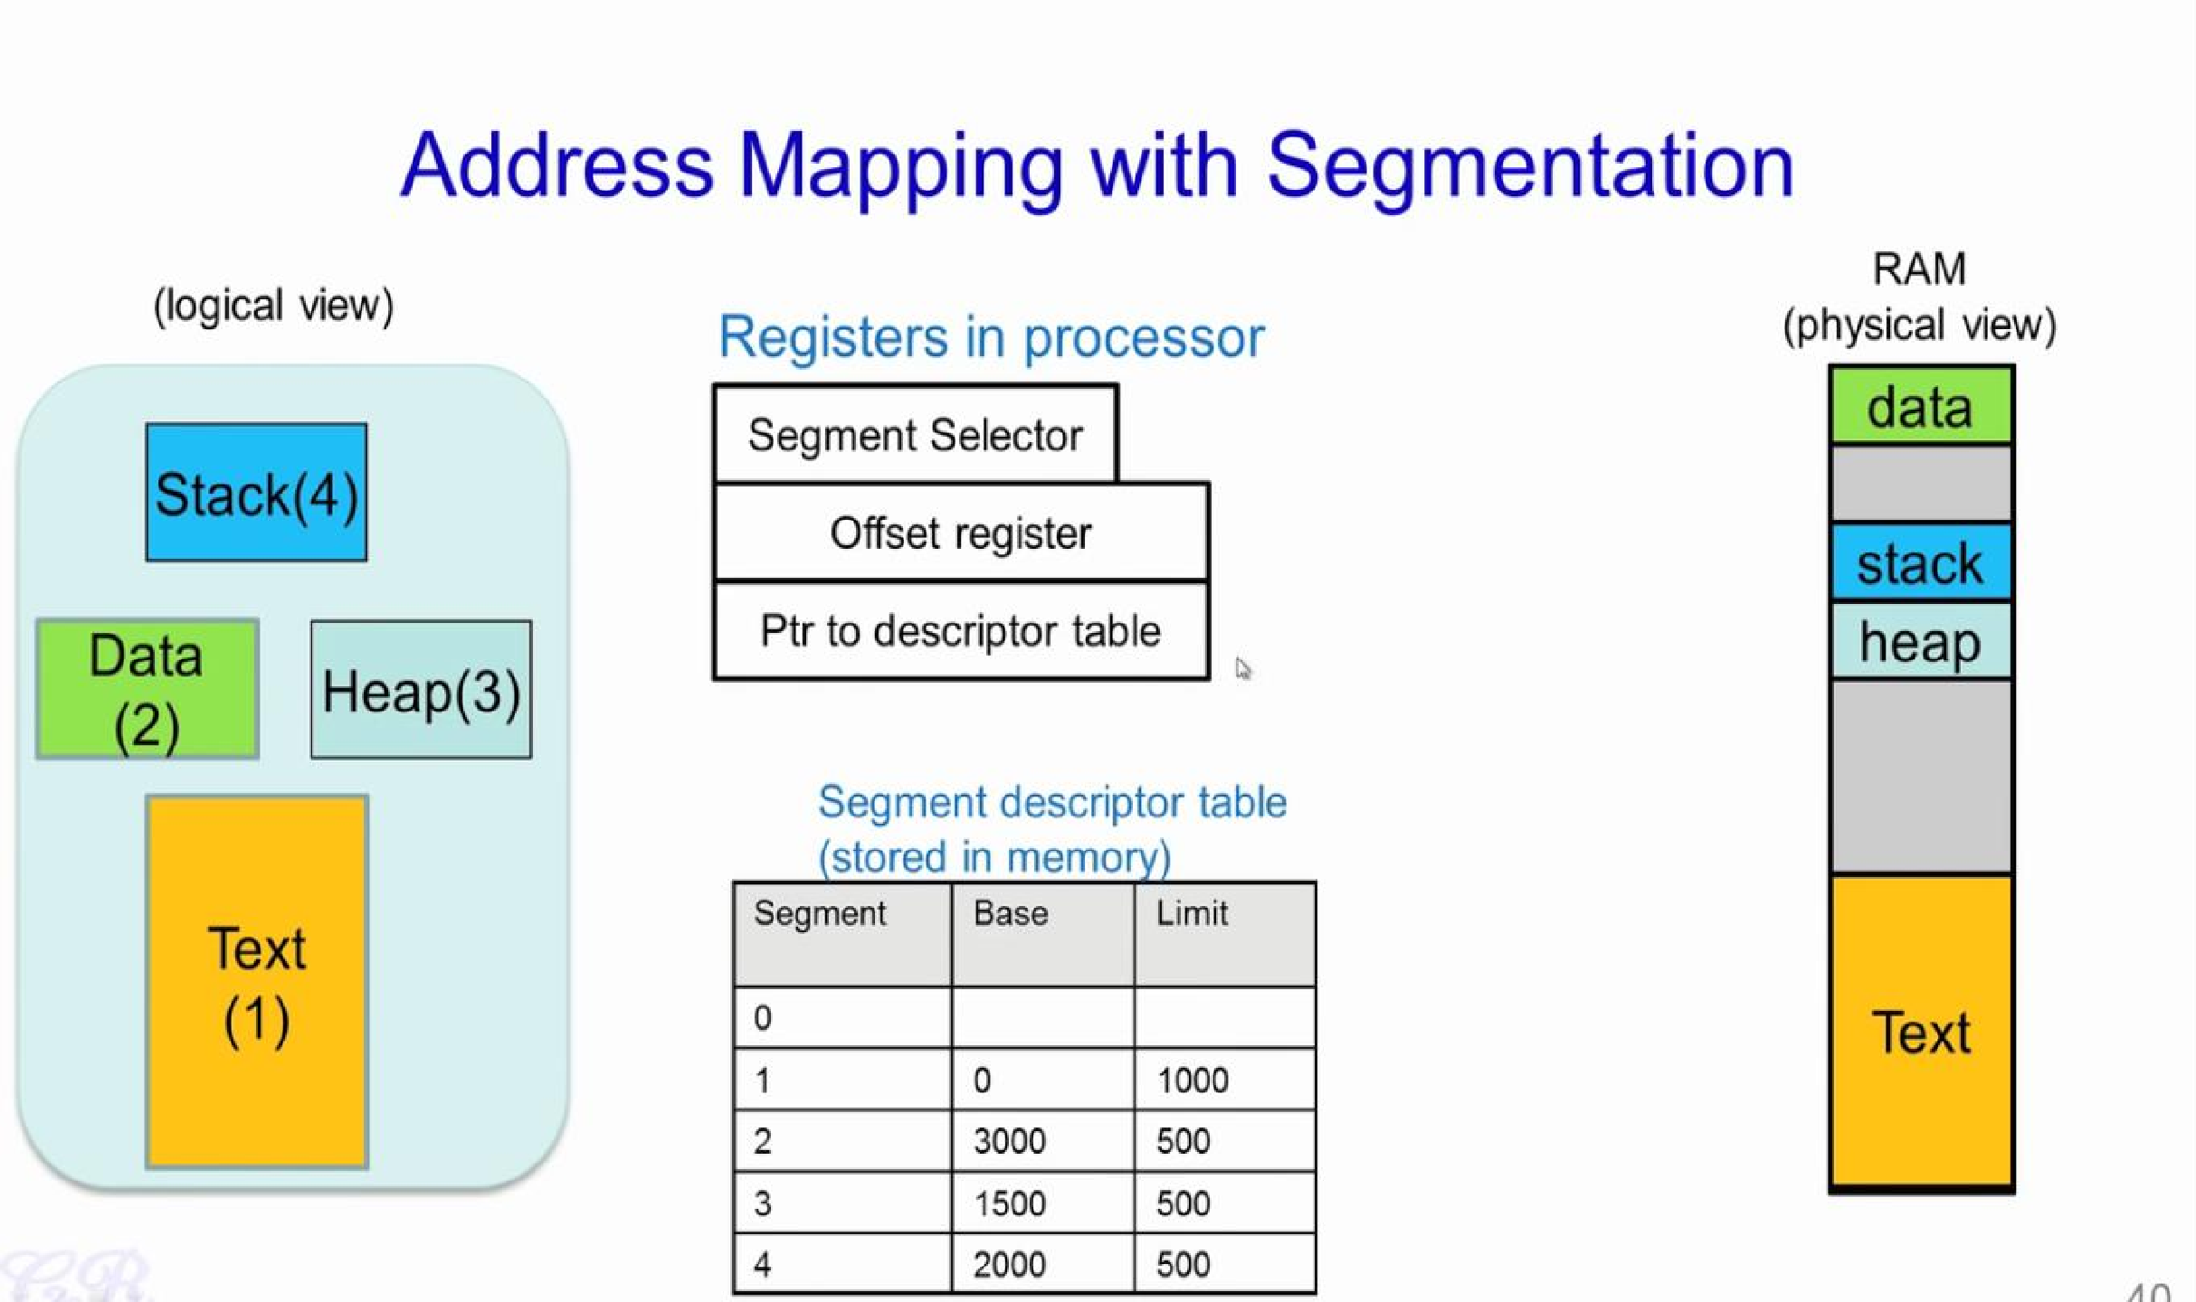

Slide 4
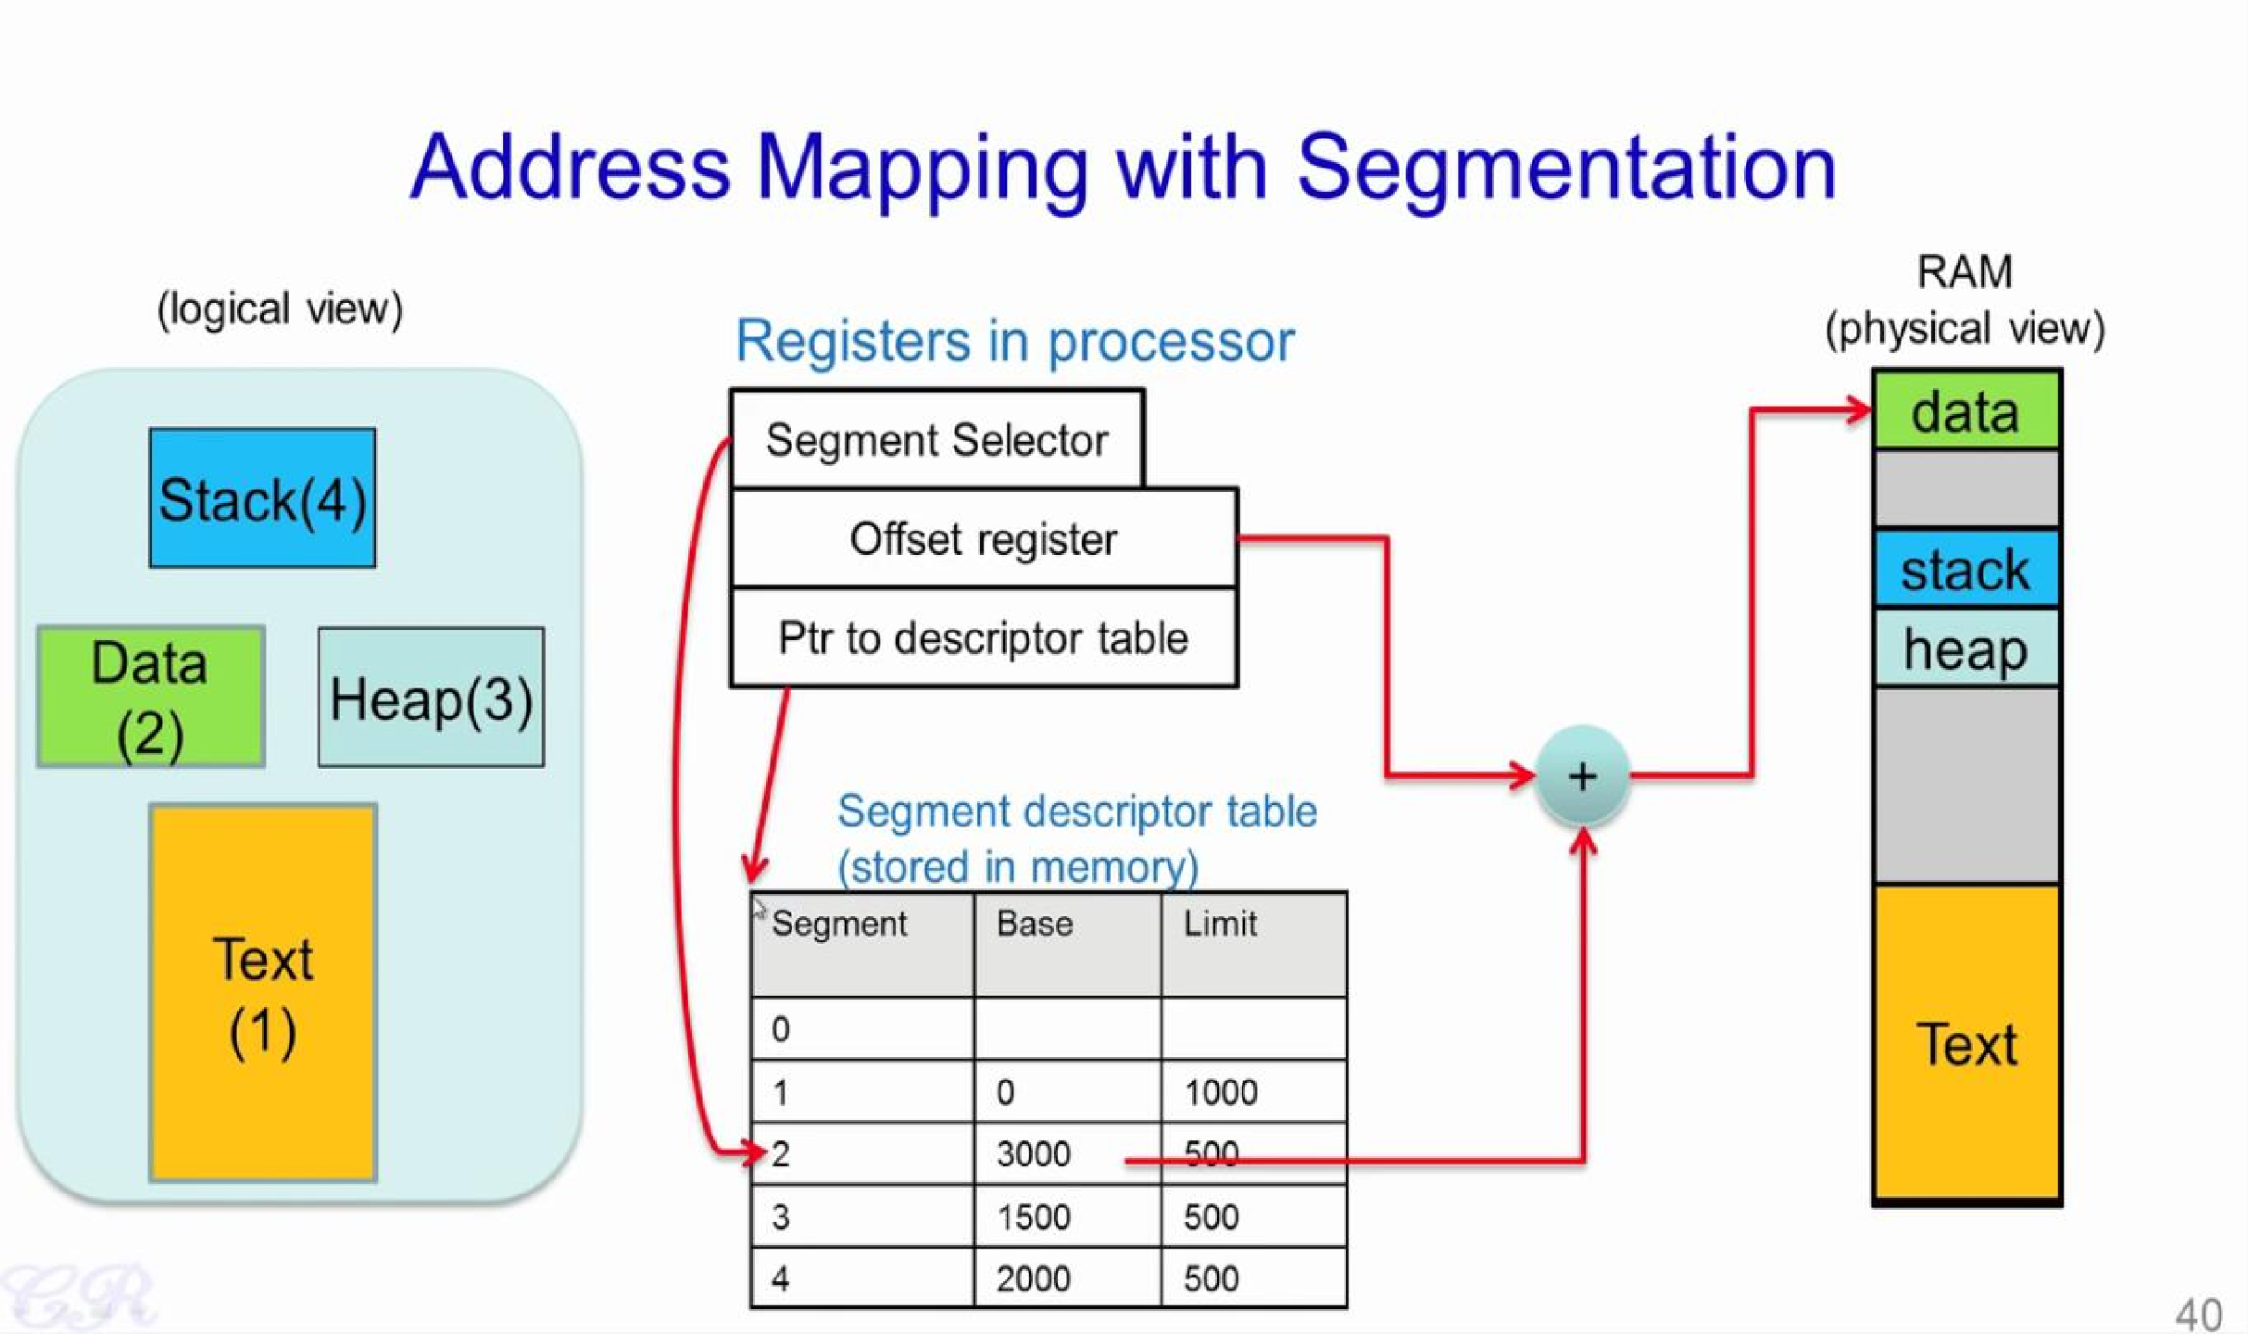

Slide 5
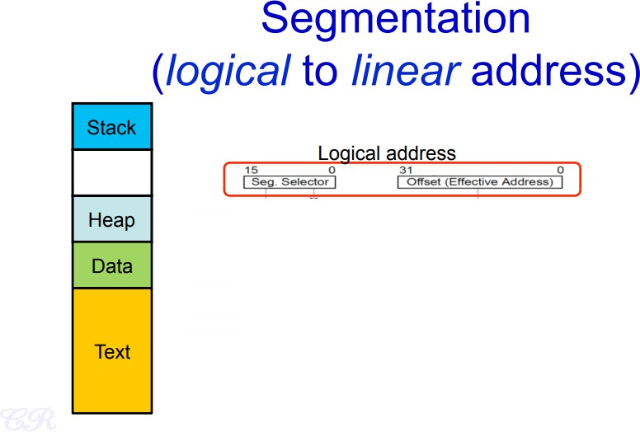

Slide 6
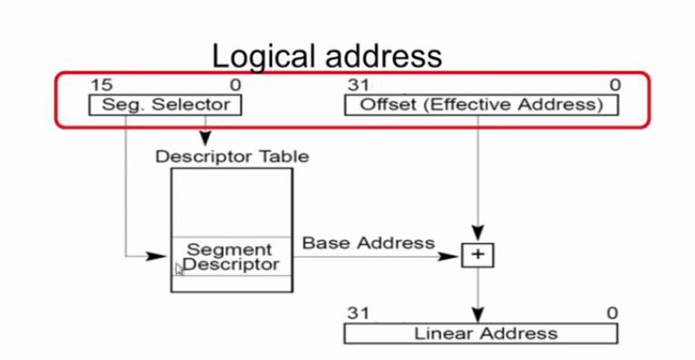

Slide 7
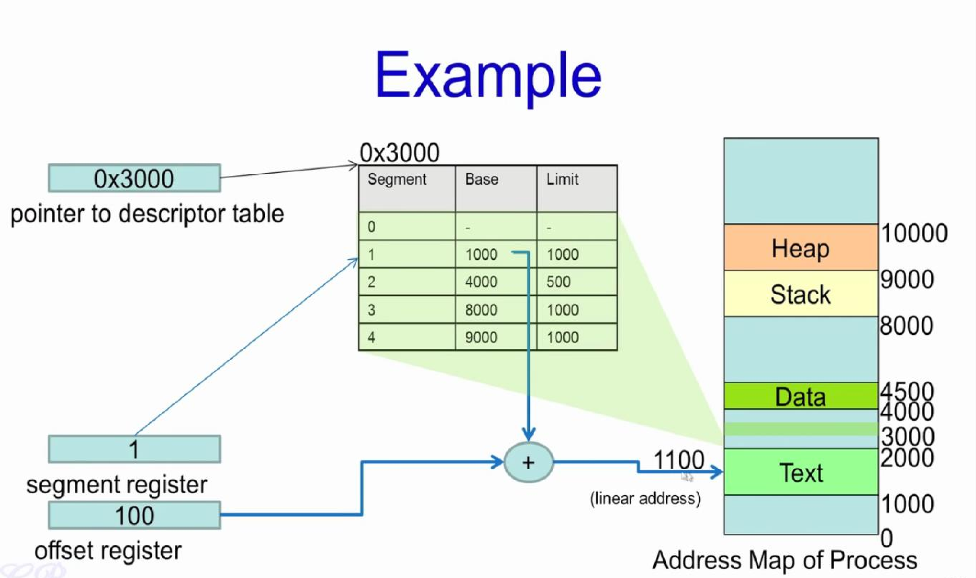

Slide 8
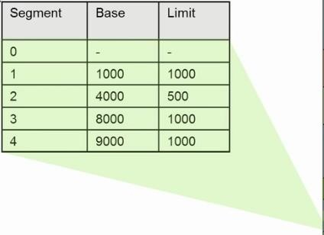

Slide 11
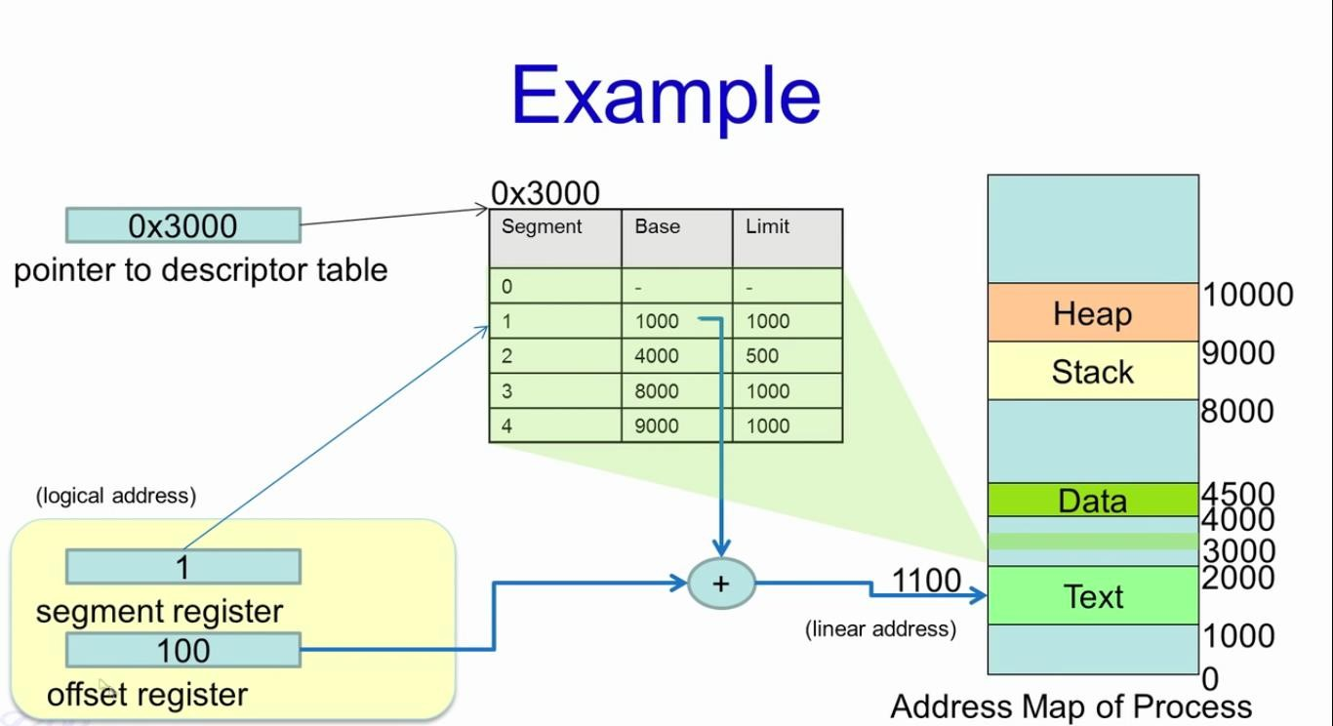

Slide 12
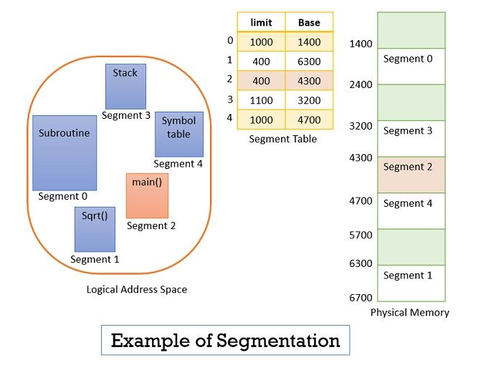

Slide 13
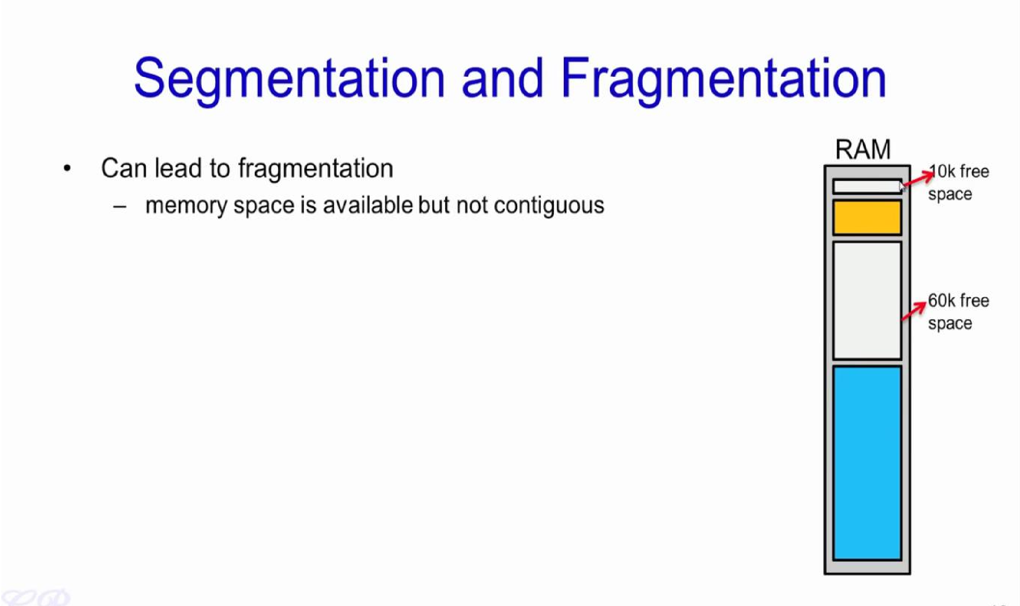

Slide 14
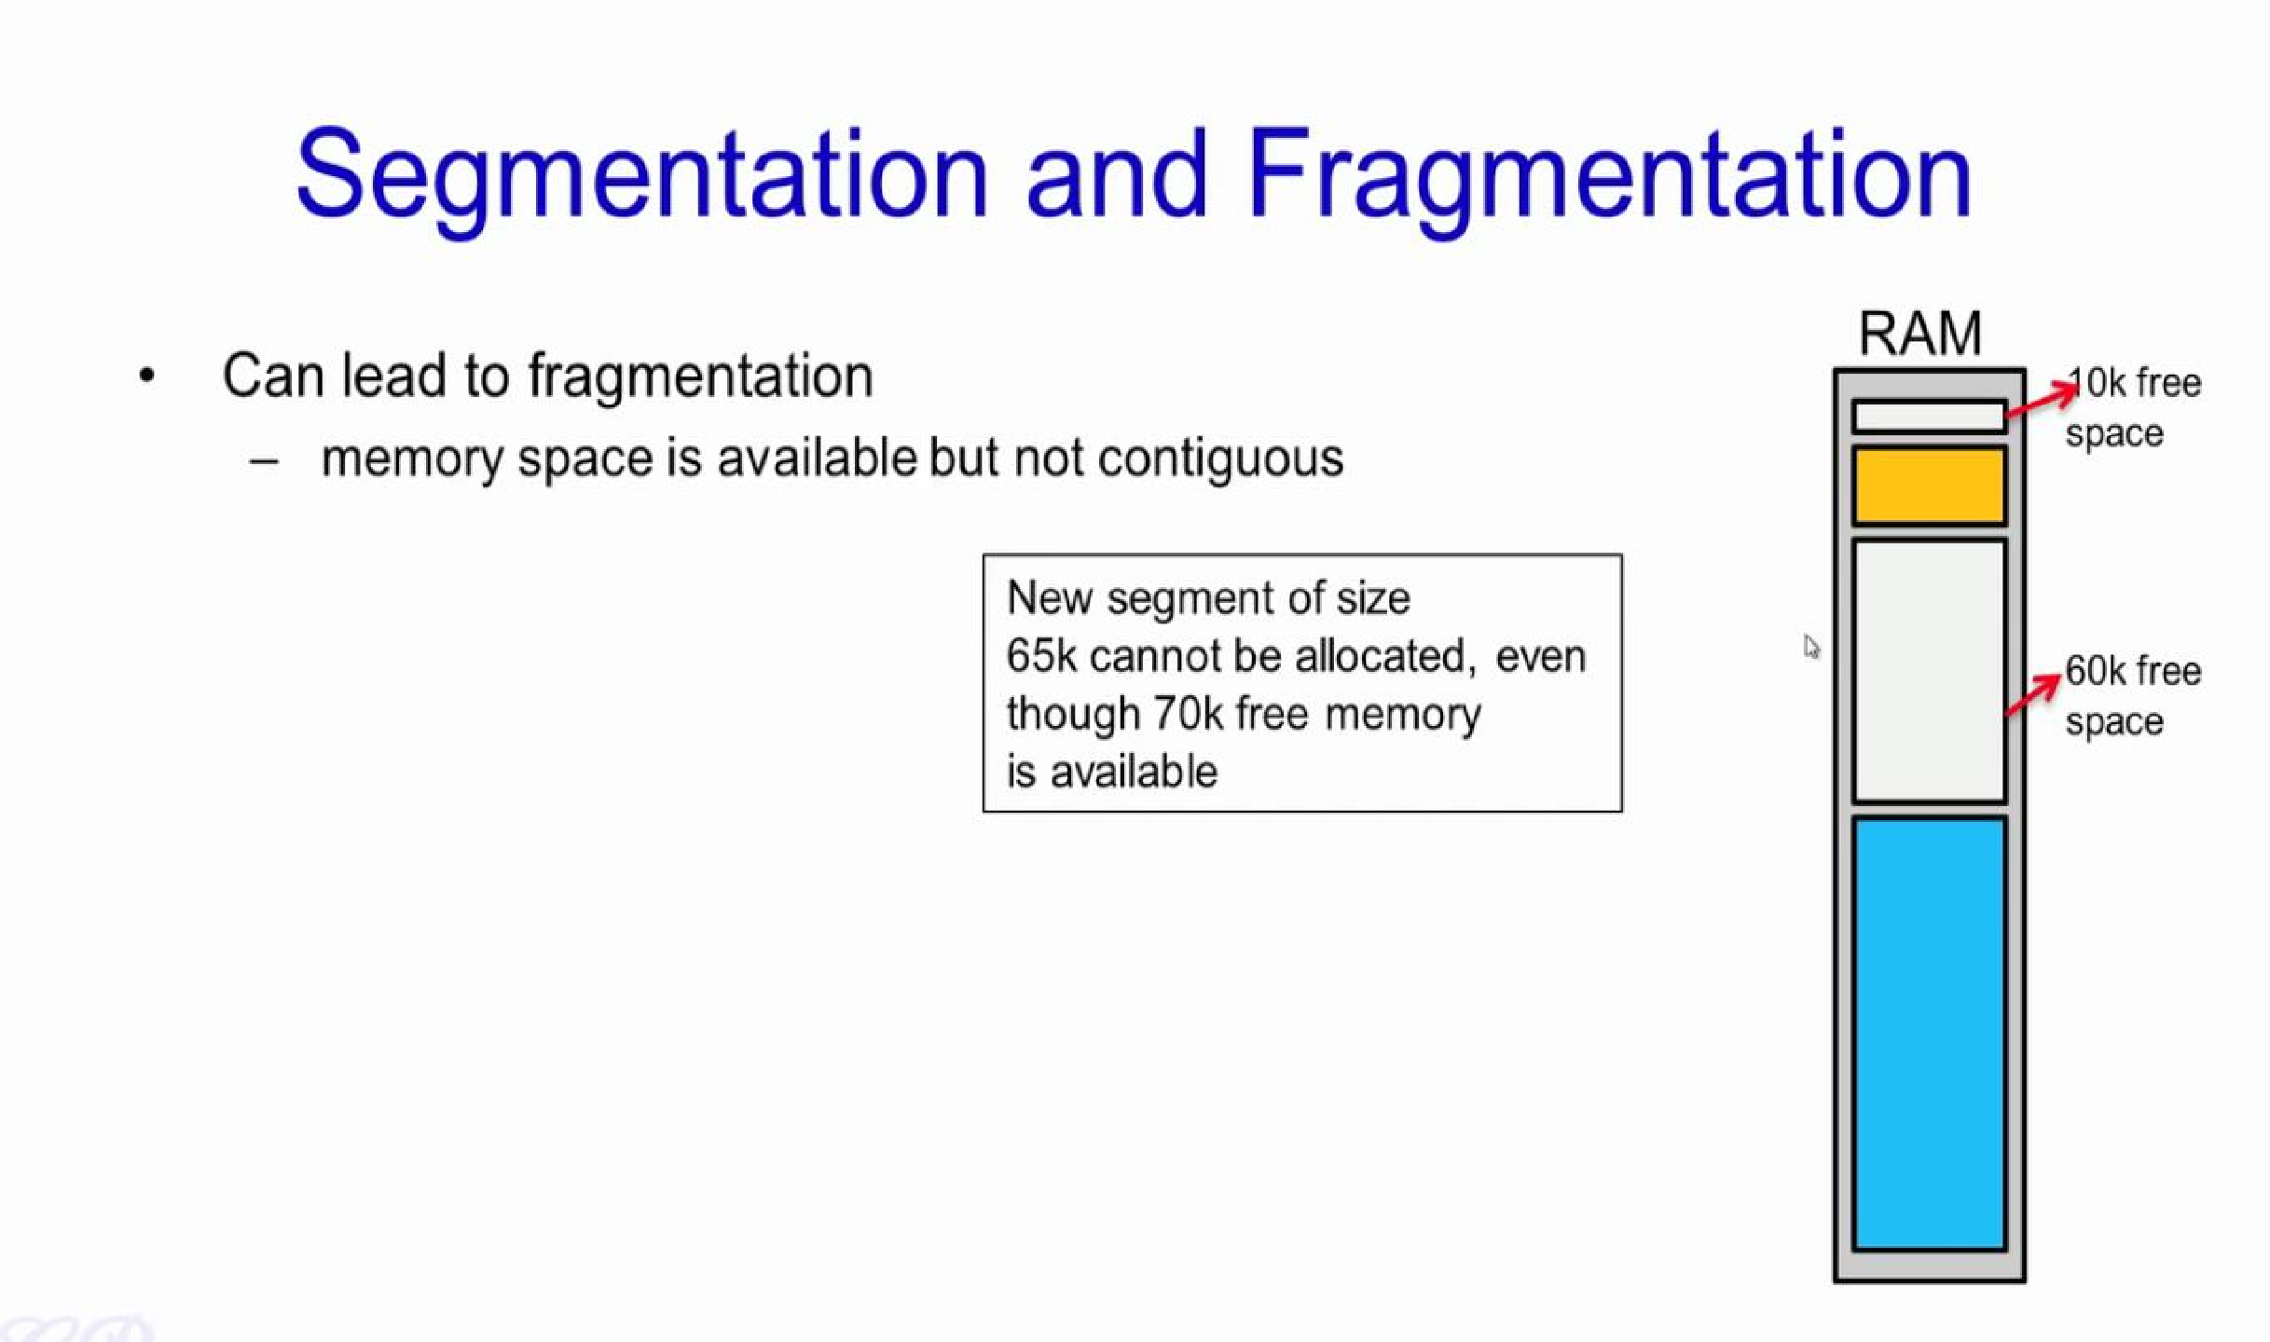

Slide 15
Segmentation Architecture
Logical address consists of a two tuple:
<segment-number, offset>,
Segment table – maps two-dimensional physical addresses; each table entry has:
base – contains the starting physical address where the segments reside in
memory
limit – specifies the length of the segment
Segment-table base register (STBR) points to the segment table’s
location in memory
Segment-table length register (STLR) indicates number of segments
used by a program;

Slide 16
Segmentation Architecture (Cont.)
Protection
With each entry in segment table associate:
validation bit = 0 ⇒ illegal segment
read/write/execute privileges
Protection bits associated with segments; code sharing occurs at segment level
Since segments vary in length, memory allocation is a dynamic storage-allocation problem
A segmentation example is shown in the following diagram

Slide 17
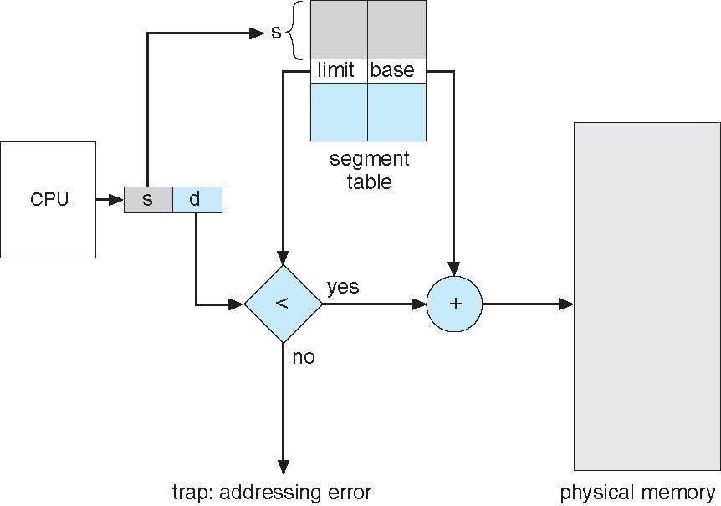
Segmentation Hardware

Slide 18
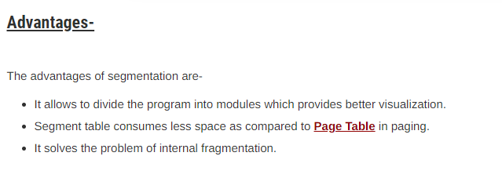

Slide 19
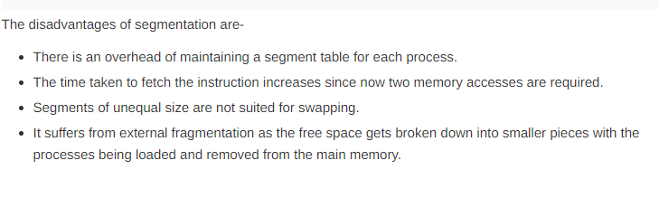
Disadvantages-

Slide 20
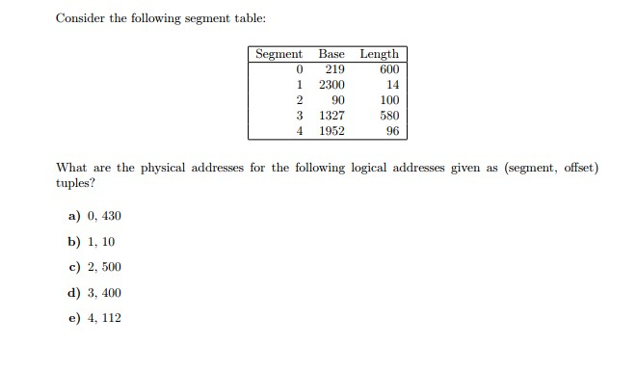
Example

Slide 21
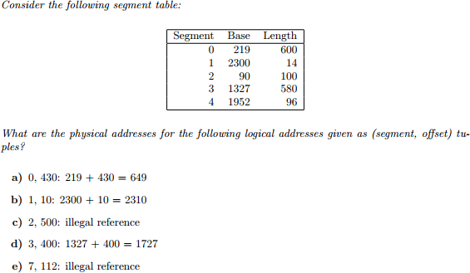
Example solution

